Slide 1
Miha Trampuž Copyright Law Institute, Ljubljana, Slovenia
First session: Specific features of copyright (and related rights) in Central Europe Gleanings from the history of Copyright Law in Slovenia Whose right is Copyright ?
Notes:
Good morning

Slide 2
Contents
1. Chapter Five Empires 2 minutes
2. Chapter Whose right is Copyright ? 6 minutes
Notes:
- I will hurry up with my presentation
- I will show the 5 Empires that ruled over Slovenia, including their Copyright legislation

Slide 3
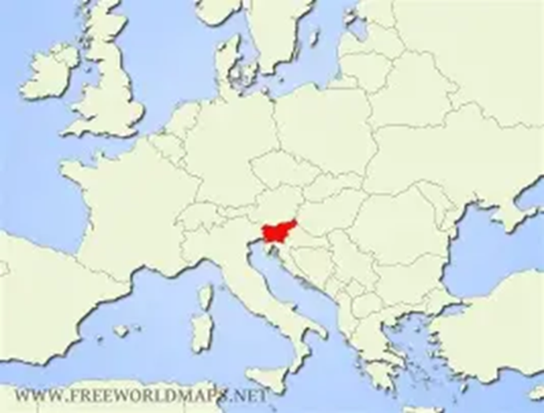
Republic of Slovenia 1991 European Union member 2004 - 1995 Act on Copyright and Related Rights -2016 Act on Collective Management of Copyright and Related Rights - 2004 Agreement on Accession to the EU
Notes:
- this is Slovenia, my little country
- I will show you how Slovenia and its Copyright Law survived under 6 Empires

Slide 4
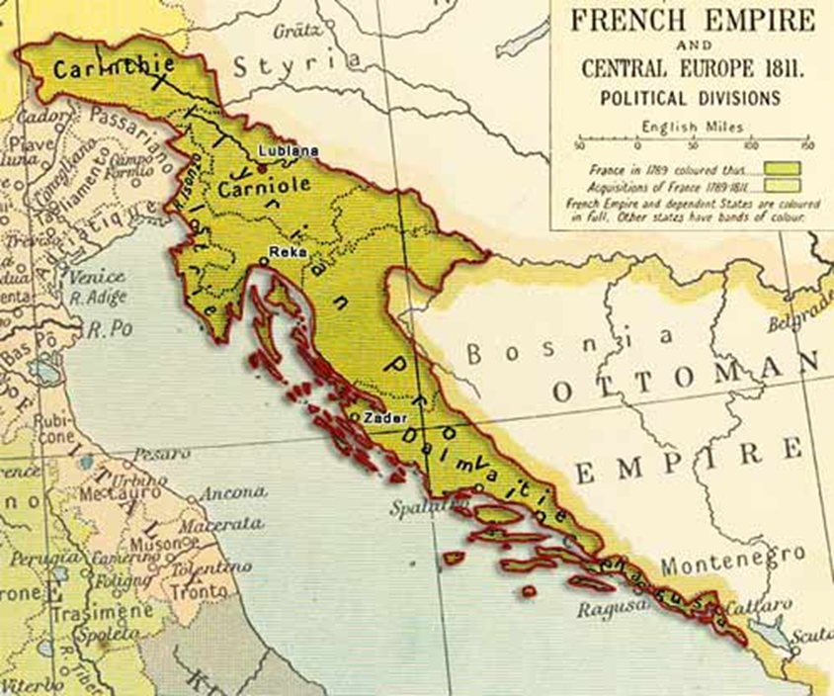
Provinces illyriennes 1809-1813
- 1791 Décret spectacles - 1793 Décret-Loi propriété des auteurs etc. - 1793 Loi théatres, représentation etc. - 1805 Décret d‘ouvrages posthumes - 1810 Code pénal
www.dlib.si Télégraphe officiel 1811, št. 42-45
Notes:
- Napoleonic Wars: after the Treaty of Pressburg/Bratislava (1805) and especially after the Treaty of Schönbrunn (1809), Kingdom of Austria lost Carinthian
western territories (Gailtal), Carniola, Gorizia and Gradisca, Trieste, Istria and Dalmatian coast till the Bay of Kotor, parts of Croatia south of the Sava river
- Provinces illyriennes were officially annexed to the French Empire, capital city Ljubljana, French governor-general Auguste de Marmont
- they brought French legal, social, and educational reforms and briefly united Slovenes and Croats, stimulated intellectual and linguistic movements that later
fueled Slovene national awakening
- after the failed invasion of Russia (1812), during the War of the Sixth Coalition (1813), by the Treaty of Paris (1814), territories restored to the Austrian Empire

Slide 5
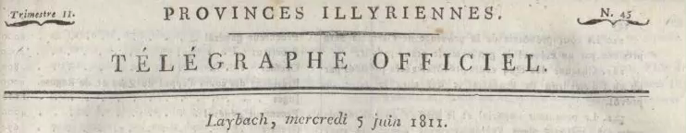

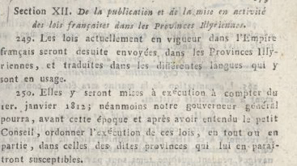
Notes:
- Les lois actuellement en vigueur dans l‘Empire francais seront desuite envoyées dans le Provinces e traduites dans les diférentes langues qui y sont en usage.

Slide 6
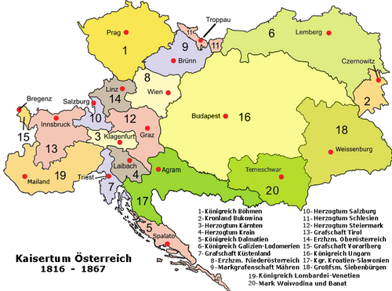
Kaisertum Österreich 1804-1867
1846 Gesetz zum Schutze des literarischen und artistischen Eigenthumes gegen unbefugte Veröffentlichung, Nachdruck und Nachbildung

Slide 7
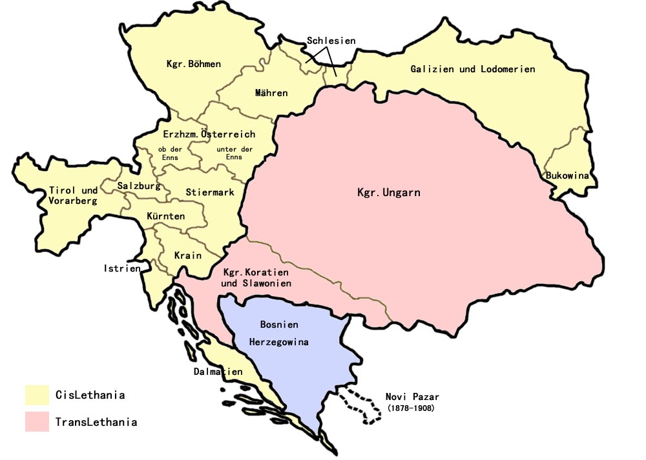
Doppelmonarchie Österreich-Ungarn 1867-1918
- 1884. évi XVI. törvénycikk a szép-irodalmi, zenemű- és művészeti tulajdonjogról - 1895 Gesetz betr. des Urheberrecht an Werken der Literatur, Kunst und Photographie

Slide 8
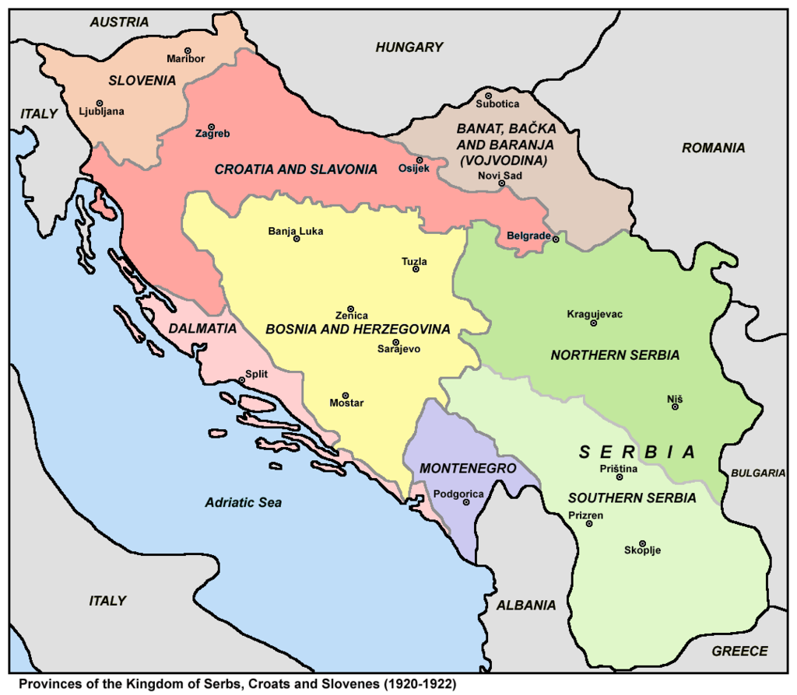
Kingdom Yugoslavia 1918 -1945
1928 ALAI Congress Belgrade
1929 Law on the protection of author‘s right

Slide 9
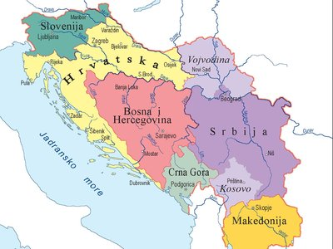
Socialist Yugoslavia 1945 – 1991
- 1946 Law on the protection of author‘s right - 1957 Law on author‘s right - 1968 Law on author‘s right - 1978 Law on author‘s right

Slide 10
Conclusion - whose right is Copyright ? (approximative)
EU

Slide 11
Conclusion - Whose right is Copyright ? (approximative)
INITIAL OWNERSHIP | Kingdom Yugoslavia 1929 | Socialist Yugoslavia 1946 | Socialist Yugoslavia 1957-1968-1978 | Slovenia 1995-2022 (EU 2004-2022)
Author – the natural person is owner | YES | YES | YES | YES
State as owner | NO | YES State may take over; State p.m.er. | YES works important for military defence | NO
Employer as rebuttable owner | / | / | YES – for 10 or 5 years | YES – for 10 years
Commissioner as rebuttable owner | / | / | NO except software; collective works | NO except software; collective works
Producer as rebuttable owner | / | / | YES (AV works) | YES (AV works)
Corrective measures REMUNERATION
- prescribed by default - best-seller-clause | / / | YES / | YES YES | YES YES
- appropriate and proportionate - inalienability (residual rights) | / / | / / | / / | YES YES
Corrective measures CONTRACTS
- specification of each transferred right - legal presumptions of transfer (rebuttable) | / YES (among co-authors) | transfers of rights are allowed only for 10 years | / / | YES YES (see above)
- prohibition of transfer of all future works - interpretation in favorem auctoris | YES / | / / | YES / | YES YES
transparency/ reporting | / | / | YES (AV works only) | YES (all works)
obligation of exploitation – revocation by author | / | / | YES AV works, publishing works | YES all works

Slide 12
THANK YOU FOR YOUR ATTENTION!

